Slide 1
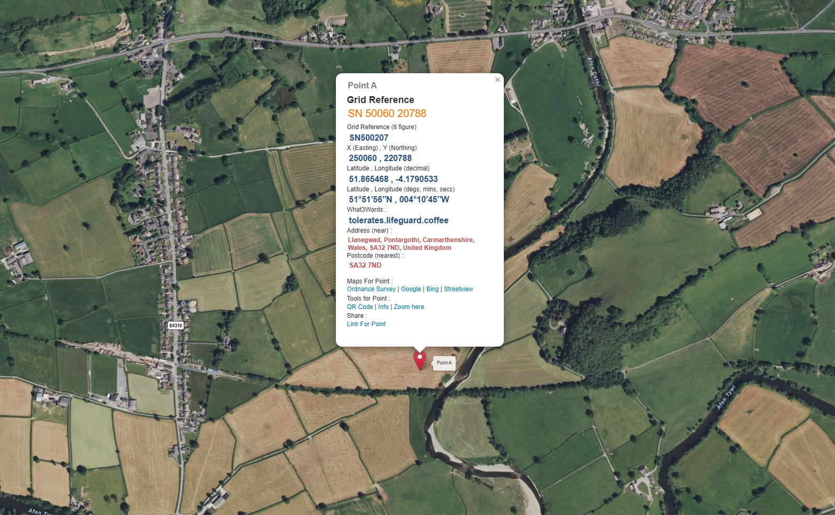
Map for Structure 3
N
Nantgaredig
River Tywi
Map taken from Grid Reference Finder website and key locations identified.
Point A identified on the maps will be location for the temporary crane pad for the project.
Walters Compound and access point to working area
River Cothi

Slide 2
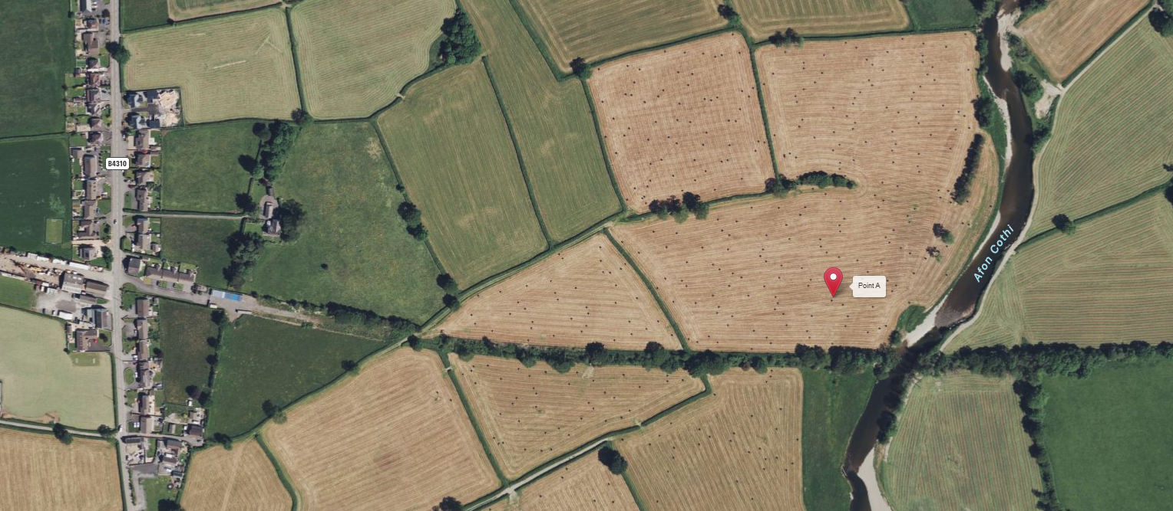
Map of Working Area
N
Nantgaredig
Location for temporary crane pad
Location for permanent footbridge across River Cothi – Structure 3
Location for Walters Compound
Access route from compound to working area

