Slide 1
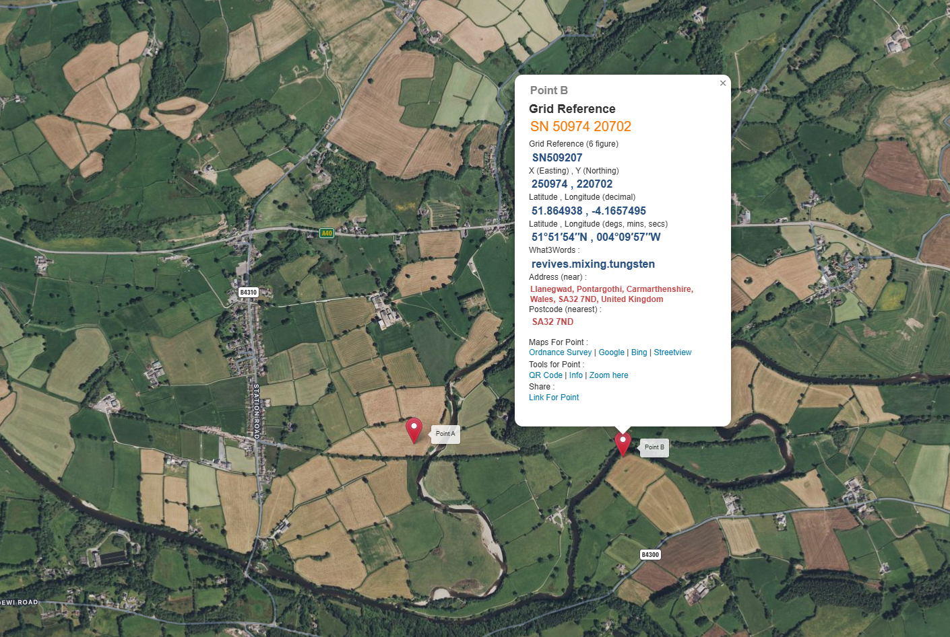
Map for Structure 5
N
Nantgaredig
River Tywi
Map taken from Grid Reference Finder website and key locations identified.
Point B identified on the maps will be location for the temporary crane pad for the project.
River Cothi
Location where River Cothi joins River Tywi
Walters Compound and access point to working area

Slide 2
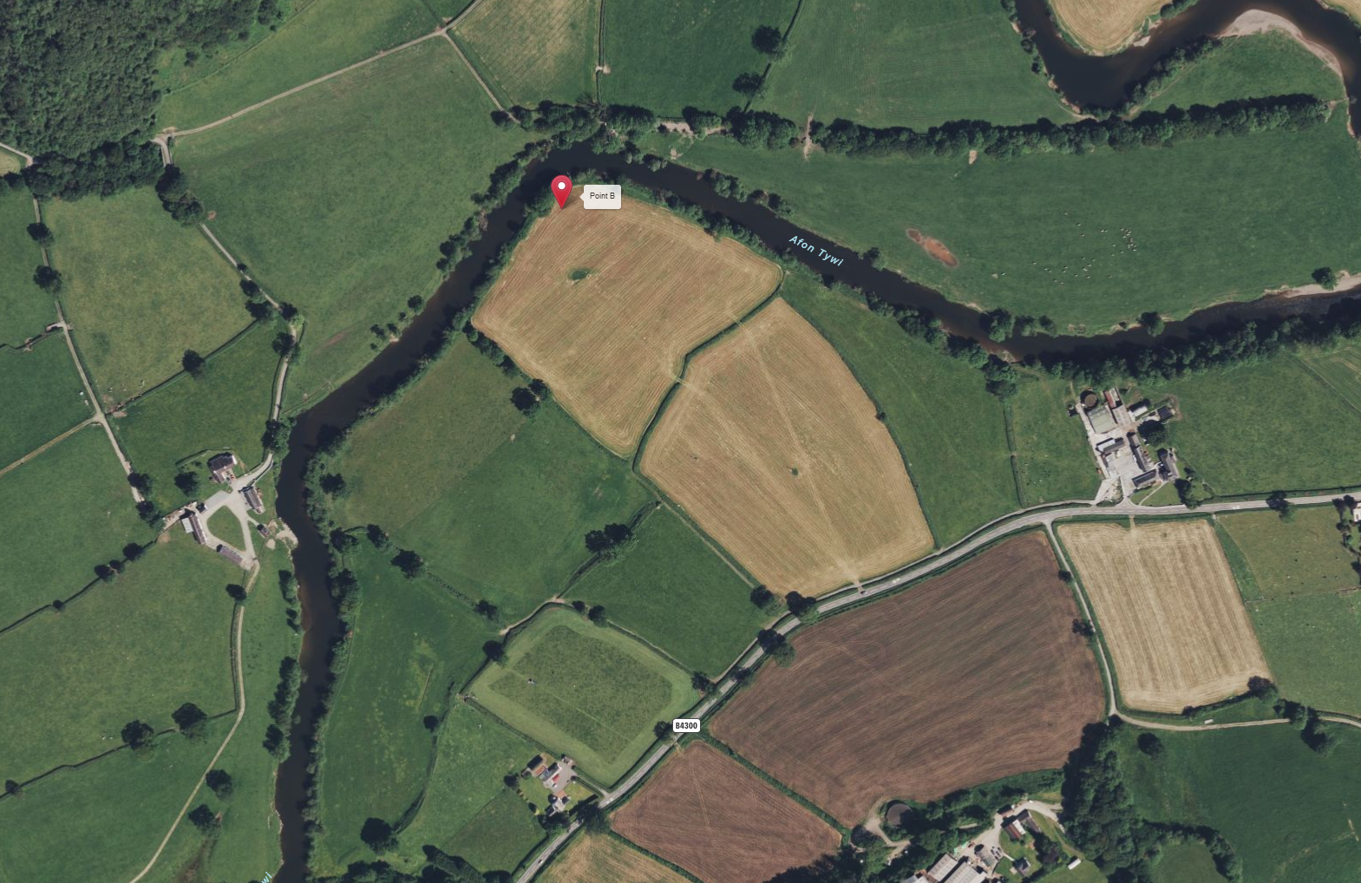
Map of Working Area
Location for temporary crane pad
N
Location for permanent footbridge across River Tywi – Structure 5
Bremenda Isaf Farm
Access route from compound to working area
Location for Walters Compound

