Slide 1
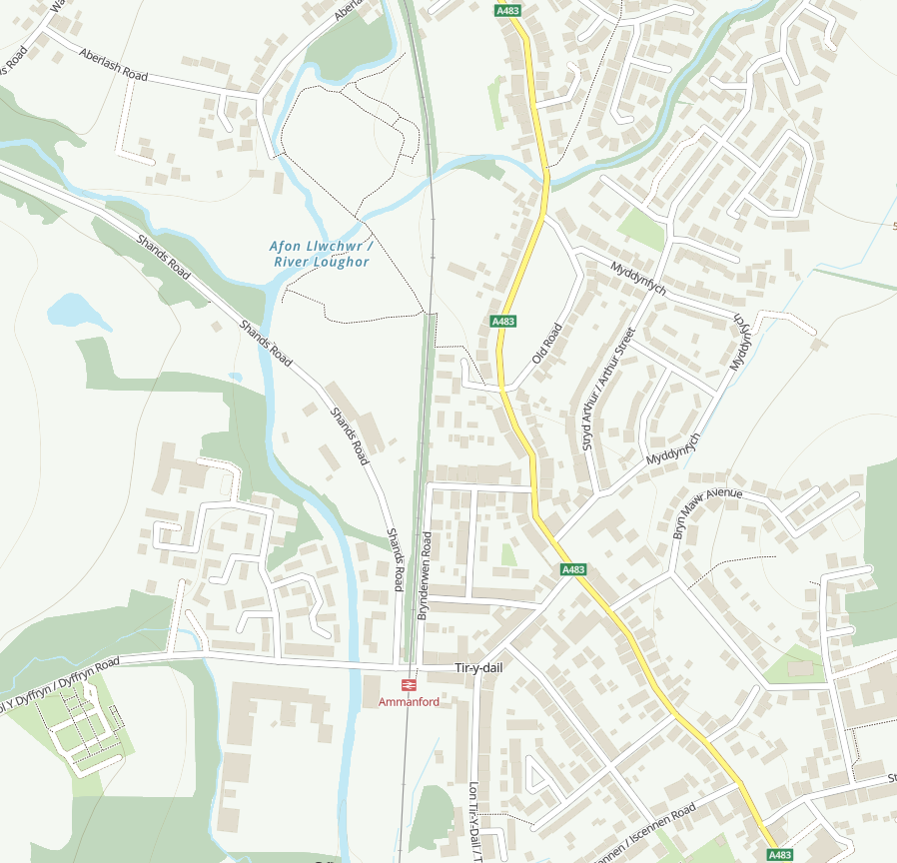
Map of Ammanford
N
River Loughor
Coleg Sir Gar – Ammanford Campus
Works area
Site Compound
Map taken from OS Maps website and key locations identified

Slide 2
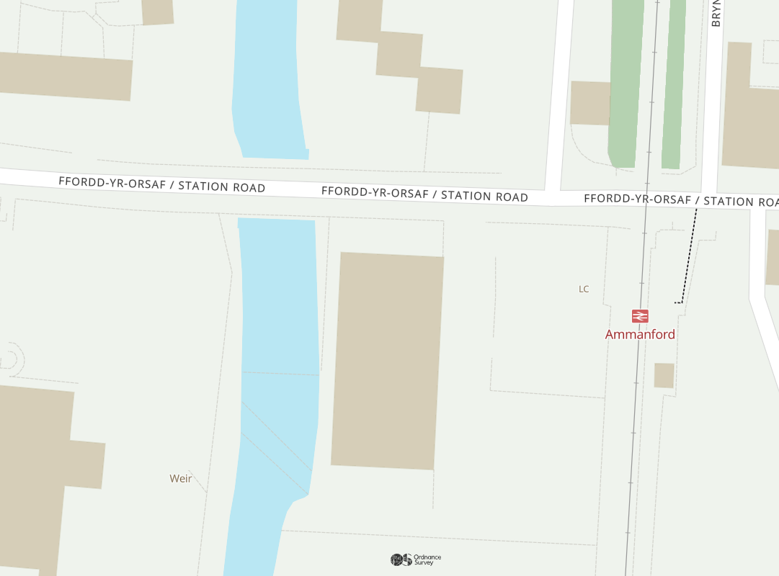
Map of Working Area
N
Working area
Site Compound
Silt mitigation measures
River Loughour

